Slide 1
Lending Club Case Study
By
Sheena Mathew

Slide 2
Business Objectives
The aim is to identify patterns which indicate if a person is likely to default, which may be used for taking actions such as denying the loan, reducing the amount of loan, lending (to risky applicants) at a higher interest rate, etc. and With the help of loan, consumer attributes and loan attributes influence the tendency of default.
The lending club company can clearly understand the driving factors (or driver variables) behind loan default, i.e. the variables which are strong indicators of default. Lending company can utilize this knowledge for its portfolio and risk assessment.

Slide 3
Problem solving methodology
Data Overview
Data Loading
Data Volume
Data Cleaning
Fix Rows and Columns
Missing Value
Derived Metrics
Type Derived Metrics
Business Derived Metrics
Standardise data
Fix invalid values
Data Content Analysis
Univariate Analysis
Segmented Analysis(Data Binning)
Bivariate Analysis
Correlation b/w features
Recomendation
Conclusion

Slide 4
Insights on Data Cleaning
1. Dropping below list of columns , since the below features do not add any value to the analysis
Columns which have full null values.
Columns which have only one unique value.
Checking for duplicate records taking id as subset, no duplicate rows found.
Columns where all values are unique. for instance id,member_id,url.
.Columns that do not contribute to check the analysis of defaulters list , it is mostly for post loan approval stage
[title, ip_code,addr_state,desc,last_credit_pull_d,out_prncp_inv,,total_pymnt,total_pymnt_inv,revol_bal,total_rec_prncp total_rec_int,total_rec_late_fee,recoveries,collection_recovery_fee,last_pymnt_d,last_pymnt_amnt,next_pymnt_d,delinq_2yrs,pub_rec_bankruptcies’
funded_amnt is removed as it is amount that is approved by the lending club and not by the investors.
Columns which has more 50% null values are dropped. for instance::mths_since_last_record and mths_since_last_delin
Records pertaining to Current are removed, as it is ambiguous whether they would repay the amount or not
emp_title is dropped as it has lot of unique values

Slide 5
2. Missing values
Based on the missingno analysis , 2 columns were found with more than 0% null values
[emp_length,revol_util]
emp_length was imputed with mode value
revol_util were filled with median since it had skewness
3 . Standardize Data
Incorrect data types are replaced with proper data type for the below columns
- int_rate is converted to float object from string object
- issue_d and earliest_cr_line is converted to datetime object
Detecting and Removing Outliers.
Data is categorized into numerical variable and categorical variable.
outliers found in ['annual_inc','inq_last_6mths','open_acc'] were capped with min and max value.
After Data cleaning , Size of the Data Frame is (38577, 21)

Slide 6
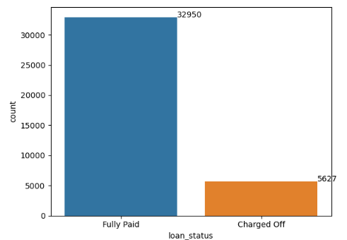
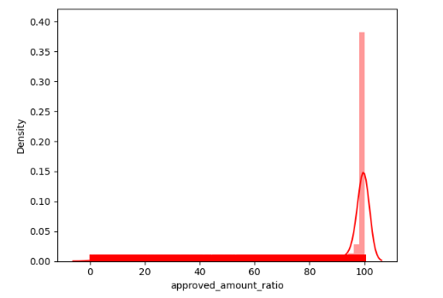
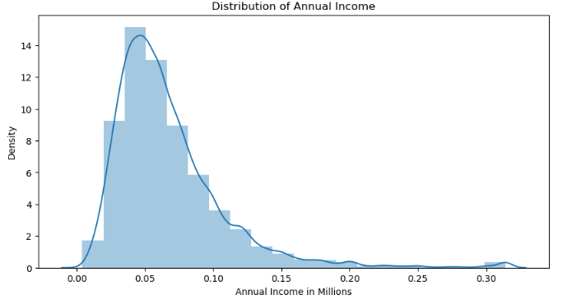
Data Analysis
only 13% loan applicants have defaulted the loan
90% of the applicants loan was approved by the investor
Annual Income is left skewed normal distribution ,therefore majority burrowers have relatively low income than others

Slide 7
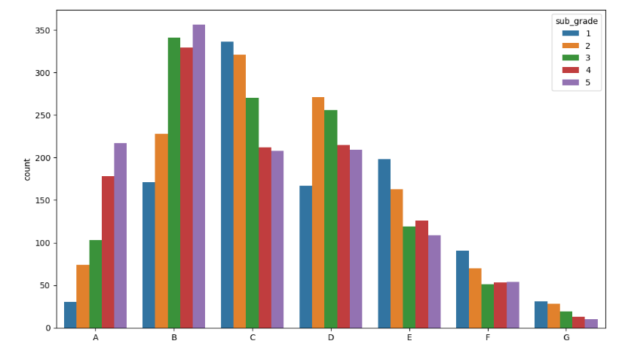
Data Analysis
Loan status( charged off) is taken as target variable
1.Grades vs Loan Status
- Majority of the loan defaulters belongs to A and B grades
- for Grade C,E, F and G. sub grade 1 has defaulted the most compared to other subgrades but for A and B subgrade 1 has defaulted the least

Slide 8
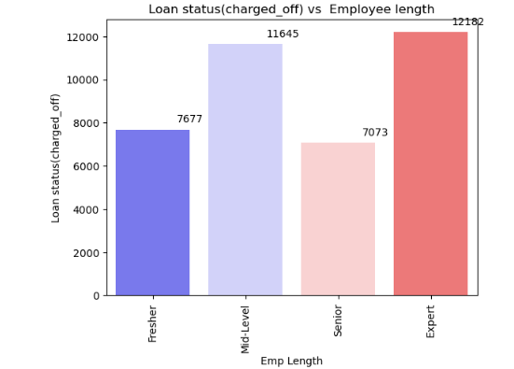
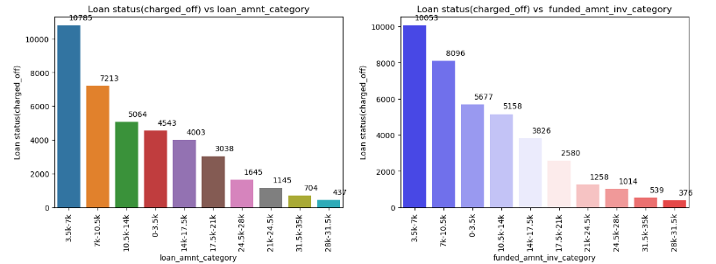
2.Employee length vs Loan Status
3.Loan Amount Category vs Loan Status
4.Funded Amount inv category vs Loan Status
- Applicants who are charged off belongs to Expert Category(i.e they have experience more than 7 years)
- funded amount is in the range of 3500-7000

Slide 9
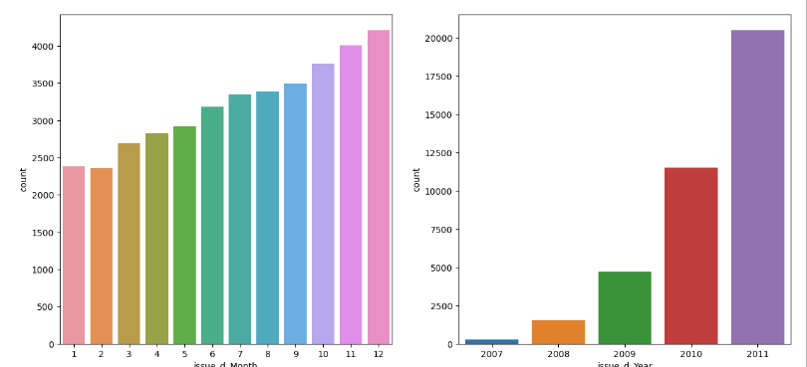
5.Loan status vs Loan Issued Month and Year
Applicant whose loan was issued in the year 2011 and in the month of December have defaulted the most.
It might be because of the 2011 financial Crisis that took place in US

Slide 10
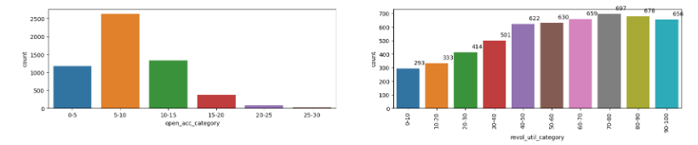
6.Loan Status vs open account category
7.Loan Status vs Credit utilization Ratio
- Higher the credit utilization rate , higher the default rate
- Applicants who have 5-10 open_acc , have defaulted the most

Slide 11
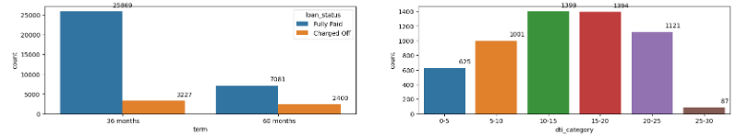
8. Loan status vs Term
9.Loan Status(Charged off) vs DTI Category
- Most of the Applicants have taken 36 month term to pay the loan off
Majority defaulters are those who have taken 60 months term ,As there is only 11% default case in 36 month as compared to the ones who have taken loan for 60 months period.
- Maximum defaulters have DTI is in the range of 10-15 .

Slide 12
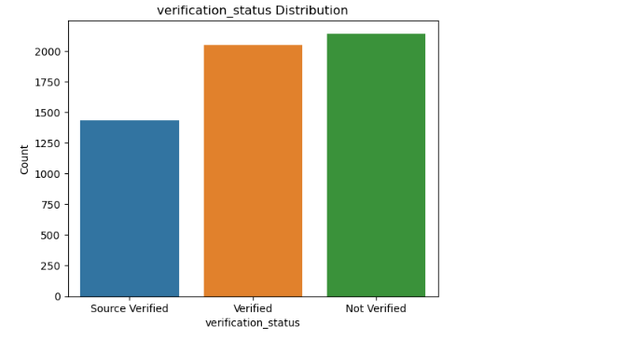
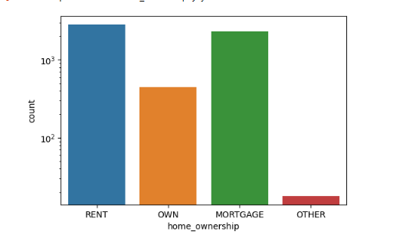
10.Loan Status(Charged off) vs Verification status
11. Loan Status(Charged off) vs Home Ownership
-Annual Income and other document were not verified for the vast majority of the defaulters
- Applicants having house_ownership as 'RENT’ have defaulted the most

Slide 13
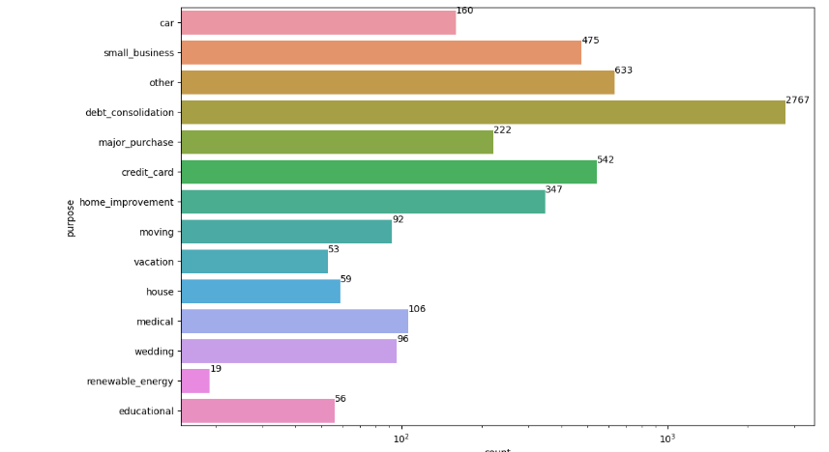
12.Loan Status(Charged off) vs Purpose
- Maximum Defaulters have taken loans based on following purpose: debt_consolidation, credit card, home improvement and small buisness

Slide 14
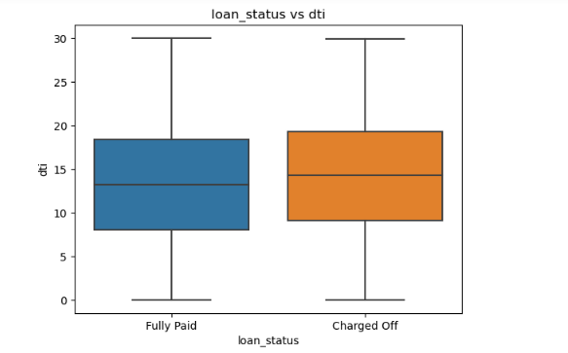
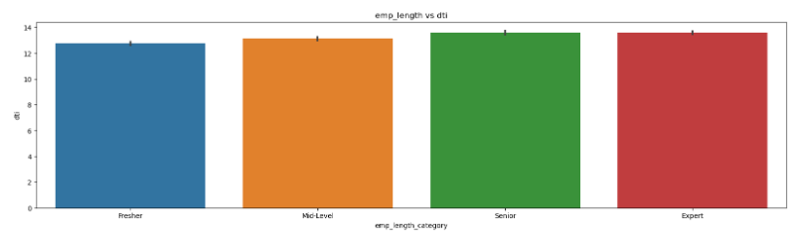
DTI as Target Variable
1.DTI vs Home Ownership
2. DTI vs emp length
- -Applicants having high DTI
- Dti is almost same for the loan applicants across all the experience category

Slide 15
Recommendation
Lending club ought to reduce the term from 60 months to 36 months.
They should have close watch on the burrowers who fall in below categories
* Applicants who fall under A and B grades
* Applicants who has more than 7 years experience
* Borrowers with mortgage home ownership .
* People with more derogatory records and the one who have high credit utilization rate.
*Borrowers who take loan for the following purposes:- debt_consolidation, credit card, home improvement and small buisness

